Slide 1
VMware CloudTM on AWS
Overview
Nico Vibert
Lead Systems Engineer – VMware Cloud on AWS
VMware Cloud on AWS

Slide 2

VMware and AWS partnering to deliver a seamlessly integrated hybrid cloud
Jointly engineered solution delivers the best of VMware and AWS for customers
  Leading compute, storage and network virtualization capabilities
  Support for a broad range of workloads
  De-facto standard for the enterprise DC
  Flexible consumption economics
  Broadest set of cloud services
  Global scale and reach
Oct 2016 – Pat & Andy announce partnership
Aug 2017 – Initial availability of VMware Cloud on AWS
Aug 2018 – AWS RDS on vSphere announced
Nov 2019 – VMware Cloud on AWS Outposts
& VMware Cloud Foundation on EC2 Outposts

Slide 3
VMware Cloud on AWS
  Rich VMware SDDC delivered as a cloud service on AWS
  Consistency and familiarity of VMware technologies
  Easy workload portability and hybrid capabilities
  Direct access to the power of native AWS services
  Existing and new apps with Containers
  and VMs

Slide 4
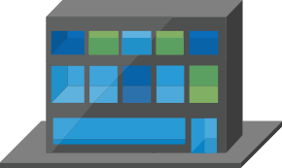


VMware Cloud on AWS
Service Overview
vRealize Suite, ISV ecosystem
Service Highlights
Private Cloud
VMware Cloud™ on AWS
Native AWS Services
    VMware SDDC running on AWS bare metal
    Sold, operated and supported by VMware
    On-demand capacity & flexible consumption
    Full operational consistency with on-premises SDDC
    Seamless workload portability and hybrid operations
    Multiple Networking Options
    Global AWS footprint, reach, availability
    Direct access to native AWS services
vCenter
vCenter
vSphere
vSAN
NSX
Customer Data Center
AWS Global Infrastructure
AWS Global Infrastructure

Slide 5
VMware Cloud on AWS
Networking Options
Public Internet
L3 VPN / BGP
172.16.10.0/24
L3 VPN
172.16.20.0/24
Traditional IPSec VPN Tunnel over Internet or BGP over DX
Compatible with any on-premises router.
Interconnect two distinct network ranges.
10.10.10.0/24
L2 VPN
10.10.10.0/24
192.168.10.0/24
HCX
192.168.10.0/24
NSX L2 VPN
Stretch networks between private and public cloud.
Requires installation of NSX Standalone Edge Client on-prem (does not require NSX licensing on-prem).
Easy to configure.
Direct Connect
172.16.10.0/24
BGP (L3 VPN optional)
172.16.20.0/24
10.10.10.0/24
L2 VPN
10.10.10.0/24
192.168.10.0/24
HCX
192.168.10.0/24
HCX
L2VPN (or L3VPN if no requirement to stretch network), combined with WAN Optimization engine and vSphere compatibility back to vSphere 5.0.
Best option for bulk migration.
Highly Secure (IPSec with AES 256 Suite-B encryption)
Data Center
Interconnection
VMware Cloud on AWS

Slide 6
Powerful use-cases that align with your cloud strategy
Data Center Extension & Disaster Recovery
Cloud Migrations
Next-Generation Applications
  Footprint expansion
  On-demand capacity
  Test & Development
  Disaster Recover & Backup
  Application specific migration
  Datacenter wide migration
  Infrastructure refresh
Application Migration
Next-Generation Application build out

Slide 7












VMware Cloud on AWS Customers
NOT EXHAUSTIVE
Broad adoption across various industries and segments

Slide 8
Flexible consumption models
Consumption-based Billing
Various Payment Methods
On-demand / hourly model
1 or 3-year reserved model
Buy add-on services
VMware SPP or HPP Credits
Purchase Orders
Credit Card

Slide 9
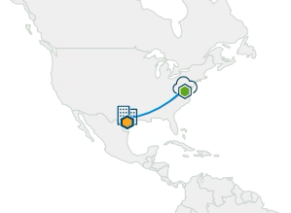
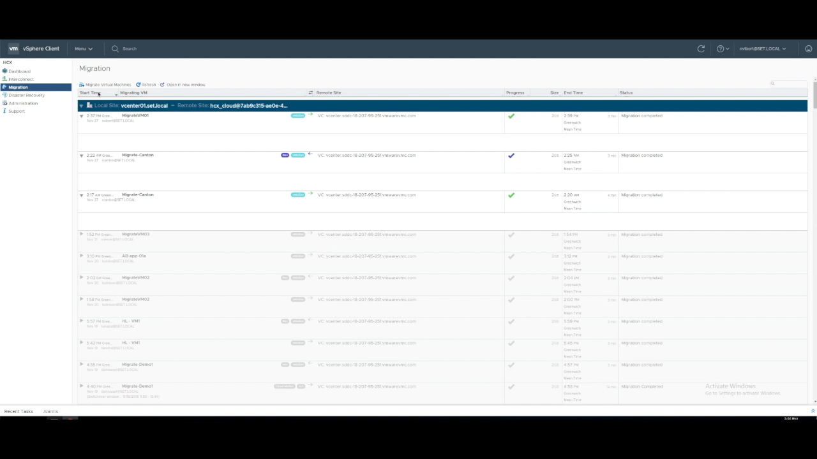
Migrating to the Cloud should be that easy
4-minute vMotion across 2,000 kms
VM

Slide 10
Various ways to migrate to VMware Cloud on AWS
Migration type | Optimized for individual workload migration |  | Optimized for large scale workload migration
Feature | vMotion | Cold Migration | VMware Hybrid Cloud Extension (HCX) for large-scale migration | VMware Hybrid Cloud Extension (HCX) for large-scale migration with replication
Description | Migration of a powered-on VM | Migration of a powered-off VM | Migration of multiple VMs (whether powered-off or on) | Migration of multiple VMs (whether powered-off or on) with background replication
What the customer gets | Single-cloud support FIPS Compliant security | Single-cloud support FIPS Compliant security | Multi-cloud support Suite-B encryption WAN Optimization | Multi-cloud support Suite-B encryption WAN Optimization Enhanced by Replication
Consumption | vCenter HTML5 Client PowerCLI | vCenter HTML5 Client PowerCLI | vCenter On-prem REST API Automation | vCenter On-prem REST API automation
What the customer needs to do/have | vSphere 6.0U3+ AWS Direct Connect(Private VIF) L2 VPN (via NSX) HLM (Optional) | vSphere 6.0U3+ L3VPN HLM (Optional) | vSphere 5.0+ (cold migration) vSphere 5.5+(vMotion) L2 VPN (Via HCX) | vSphere 5.0+ (cold migration) vSphere 5.5+(Replication Assisted vMotion) (*Developing) L2 VPN (Via HCX)
Available As/ Need Set-up? | Part of VMware Cloud on AWS | Part of VMware Cloud on AWS | Part of VMware Cloud on AWS (New!) Automated component install & in-service updates (deploy 1-4 appliances on-premises) | Part of VMware Cloud on AWS (New!) Automated component install & in-service updates (deploy 1-4 appliances on-premises)

Slide 11

VMware Cloud on AWS is a VMware Service
Service is delivered, operated, sold and supported by VMware
VMware CloudTM on AWS
Powered by VMware Cloud Foundation
vSphere
vSAN
NSX

Slide 12
Connecting Clouds
Options to connect to VMware Cloud on AWS
  IPSEC VPN to Existing Network Architecture
VMware Cloud on AWS
  L2 VPN to stretch networks between clouds
vSphere
vSAN
NSX
  HCX – L2VPN + WAN Opt + vSphere compatibility
AWS Direct Connect
Private connection (secure tenancy)
Fast connection (1GbE or 10GbE)

Slide 13
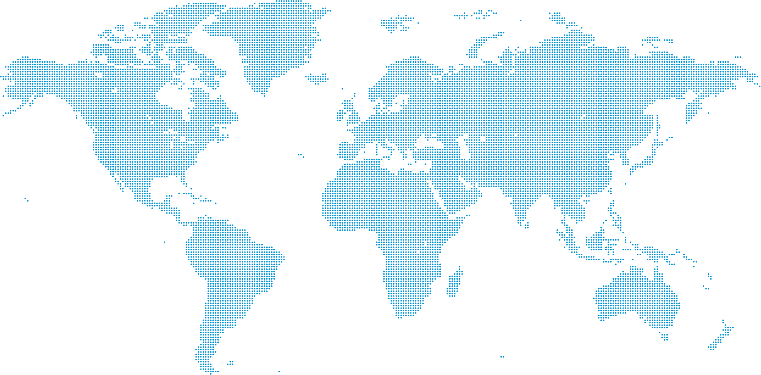
Simultaneously expanding to multiple global AWS Regions
3
3
3
3
3
3
2
3
3
3
3
3
2
1
2
#
Available Regions and # of Availability Zones (AZs)
US West (Oregon)
US East (N. Virginia)
Europe (London)
Europe (Frankfurt)
Asia Pacific (Sydney)
Europe (Ireland)
*US West (N. California)*
US East (Ohio)
Asia Pacific (Tokyo)
Gov Cloud US West
2
3
2
3
March 2019 | Q2 2019 | Q3 2019 | Q4 2019 | 1H2020 (est.)
Asia Pacific (Singapore) | *South America (Sao Paulo)* | Europe (Sweden) | Bahrain | China (Mainland)
*Canada (Central)* | *Asia Pacific (Seoul)* | China (Hong Kong) | Gov Cloud US East | Cape Town
Europe (Paris) | **Asia Pacific (Osaka-Local)** |  |  | Milan
 | *Asia Pacific (Mumbai)*
#
#
#
#
Last updated: March 8, 2019
* Stretched cluster not supported (2 AZs)
** Disaster Recovery site only, gated entry

Slide 14






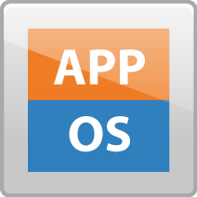





Customer Data Center
AWS Direct
Connect
VMware Cloud VPC
AWS region A
Customer VPC
free
AZ1
$0.02/GB
vCenter
Compute
Network
Storage
Cross-AZ
$0.01/GB
ESXi
vSphere
NSX
vSAN
Internet
free
ENI
@25Gbps
Cross-AZ
$0.01/GB
AZ2
vSphere Environment
free
$0.05/GB
free
free
Cross-Region
$0.02/GB
free
S3 Public end-point
Color coding
Paid by VMware – Charged back to Customer
Paid by Customer to AWS directly
Read more on:
http://www.gilles.cloud/2018/06/understanding-vmware-cloud-on-aws.html
$0.09/GB
free
free
S3 in region A
AWS region B
free

Slide 15
VMware Cloud on AWS is a service
Overview
The fully configured VMware Cloud software stack will be provisioned, operated, and maintained directly by VMware.
Provisioning
Automated account creation and environment provisioning by using the API
Automated interconnection created between VMware and AWS customer accounts
Operations
Support provided by VMware directly
AWS infrastructure (for VMware Cloud on AWS) support managed by VMware
Ongoing infrastructure monitoring
Maintenance
Ongoing stack maintenance managed directly by VMware
Upgrade implementation and execution

Slide 16
Technical

Slide 17
Restrictive Access Model
  No root ESXi access
  No VIB installations
  No VDS configuration access
  No direct management VM access
VC
NSX
PSC
VM
VM
VM
VM
VM
Customer
Managed by VMware
Managed by Customer
VMware
vSAN Cluster

Slide 18
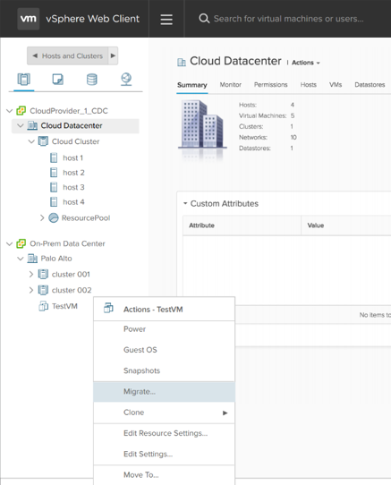
Hybrid Cloud Operations
Single view for Hybrid Cloud Management
Hybrid Linked Mode provides operational consistency
On-Premises vCenter connects to (multiple) SDDC vCenters

Slide 19
Elastic DRS Integration
THRESHOLD EXCEEDED PROVISION ADDITIONAL HOST
CLUSTER OPERATING WITHIN TARGET THRESHOLDS
CLUSTER RETURNS TO TARGET THRESHOLD
CPU
Memory
Storage
vSAN Cluster
In Development: Feature in active development and testing. This does not imply a specific timeline, since feature development times vary.

Slide 20
Automated Cluster Remediation
HOST FAILS, OR PROBLEM IDENTIFIED
NEW HOST ADDED TO CLUSTER.
DATA FROM PROBLEM HOST REBUILT, AND/OR MIGRATED
PREVIOUS HOST EVACUATED FROM CLUSTER, FULLY REPLACED BY NEW HOST
vSAN Cluster

Slide 21
Elastic Data Center Network Overview
Management Pool
  vCenter Server, PSC, NSX Manager
  NSX Edge Gateway (MGW)
  NSX Logical Switch for management VMs
  Firewall and VPN for security
Compute Pools
  NSX Edge Gateway (CGW)
  NSX Logical Switch for workload VMs
  Firewall and VPN for security
  NAT to connect VMs to the Internet
INTERNET
VC
NSX
PSC
VM
VM
VM
VM
VM
MGW
Managed by VMware
Managed by Customer
CGW
vSAN Cluster

Slide 22
Stretched Clusters for VMware Cloud on AWS
Allows developers to focus on business capabilities while infrastructure takes care of application availability
  Building on intrinsic vSphere HA as well as automated host failure remediation
  Zero RPO high availability across AZs
  Built-in infrastructure layer – no necessity to architect in the application
  Stretched cluster with common logical networks with vSphere HA/DRS enabled
  Synchronous replication between AZs for mission-critical applications
  If one AZ goes down, it is simply treated as a vSphere HA event and VM is restarted in the other AZ
VMware Cloud on AWS SDDC
Stretched Clusters
…
vSphere HA/DRS span across AZ
…
…
…
NSX logical networks
vSAN stretched cluster
AWS Availability Zone A
AWS Availability Zone B
AWS Region

Slide 23
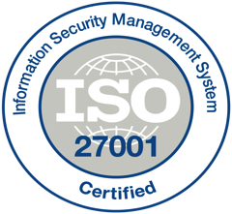
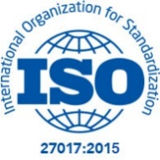
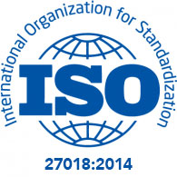
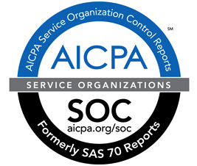



Industry certifications
Compliance Certifications, attestations and assessments
ISO 27001, 27017, 20718
SOC 1, SOC 2, SOC 3
GDPR compliance
HIPAA BAA
CSA STAR Self-Assessment

Slide 24


VMware Hybrid Cloud Extension
Service Overview
Accelerate cloud adoption App Mobility across vSphere 5.0+ version on-premises to VMware Cloud on AWS.
HCX
VM
VM
VM
Application Mobility
Hybrid Cloud Extension Multisite, WAN Optimized, Secured, Load Balanced, Traffic Engineered Network Extension
Infrastructure Hybridity
PRIVATE
CLOUD
PUBLIC
CLOUD
Transform With Bulk Migration
Zero-downtime live migrations and scheduled large-scale warm migrations.
Infrastructure Abstraction
USAGE SCENARIOS
Migrations and Transformation
Hardware/Software Refresh/upgrades
Consolidate smaller DCs to cloud
Hybrid Applications
Legacy Equipment Replacement Avoidance
Rapid Migration
Burst Capacity

Slide 25

VMware Site Recovery – built for VMware Cloud on AWS
Disaster Recovery to VMware Cloud on AWS
Delivered as an add-on service with granular, on-demand pricing
Built on VMware’s proven disaster recovery solutions
Automated DR runbook with application-centric runbooks
Bidirectional protection between cloud and on-premises as well as between AWS availability zones
Integrated deeply with the VMware Cloud on AWS services
VM
VM
VM
VM
VM
VM
VM
VM
VM
1~~~~~~~~
2~~~~~~
3~~~~~~~~
4~~~~~~~
VM
VM
VM
VM
VM
VM
VM
VM
VM
vSphere Private Cloud
VMware Cloud
on AWS

Slide 26








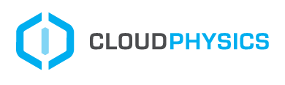

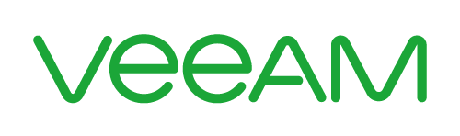













Continued broad support by 3rd party technology partners
Data Protection
Direct Connect
Security
TCO Assessment
DevOps
*
*
*
*
Key Management
Storage
Cloud Migration
*
Networking
…
…
…
…
…
* Newly added

Slide 27
Rapidly kickstart your VMware Cloud on AWS experience
Time-bound low-cost option with Single Host SDDC starter configuration
Accelerated on-boarding
Less than 1/4th price of a 4 host cluster
$7/host/hour; for new customers, discount promotion of 20% off for first 3 months*
30-day
single host configuration
Pay as you go
Hourly
on-demand
Seamlessly scale up to 4+ hosts
* The discount promotion is valid on single host purchases on or before June 5th, 2019.

